Slide 1
Lecture 12 : CSE2004 – DBMS
normalization

Slide 2
Fourth Normal Form
For a table to satisfy the Fourth Normal Form, it should satisfy the following two conditions:
It should be in the Boyce-Codd Normal Form.
And, the table should not have any Multi-valued Dependency.

Slide 3
What is Multi-valued Dependency?
A table is said to have multi-valued dependency, if the following conditions are true,
For a dependency A → B, if for a single value of A, multiple value of B exists, then the table may have multi-valued dependency.
Also, a table should have at-least 3 columns for it to have a multi-valued dependency.
And, for a relation R(A,B,C), if there is a multi-valued dependency between, A and B, then B and C should be independent of each other.
If all these conditions are true for any relation(table), it is said to have multi-valued dependency.

Slide 4
What is Multi-valued Dependency?
A multi-value dependency exists when
There are at least three attributes A, B and C in a relation.
For each value of A there is a well-defined set of values for B, and a well-defined set of values for C.
The set of values of B is independent of set C.
If a table in 4NF then -
All attributes must be dependent on the primary key, but they must be independent of each other.
No row may contain two or more multivalued facts about an entity.
Example - Course(Course_code, Professor, Reference_book)
Multivalue Dependency Course_code → → Professor Course_code → → Reference_book

Slide 5
s_id | course | hobby
1 | Science | Cricket
1 | Maths | Hockey
2 | C# | Cricket
2 | Php | Hockey
Primary key→{Student_ID , Subject , Activity }
Many Student_ID have same Subject.
Many Student_ID have same Activity.
Thus violates 4NF.
s_id | course | hobby
1 | Science | Cricket
1 | Maths | Hockey
1 | Science | Hockey
1 | Maths | Cricket

Slide 6
CourseOpted Table
s_id | course
1 | Science
1 | Maths
2 | C#
2 | Php
Hobbies Table,
s_id | hobby
1 | Cricket
1 | Hockey
2 | Cricket
2 | Hockey

Slide 7
Example 2
Manager | Child | Employee
Jim | Beth | Alice
Jim | John | NULL
Mary | Bob | Jane
Mary | NULL | Adam
Primary key→{Manager , Child , Employee }
Each manager can have more than one child.
Each manager can supervise more than one employee.
Thus violates 4NF.

Slide 8
Example 2(convert to 4NF)
Old Scheme→{Manager , Child , Employee } New Scheme →{Manager , Child}
New Scheme →{Manager , Employee}
Manager | Child
Jim | Beth
Mary | Bob
Manager | Employee
Jim | Alice
Mary | Jane
Mary | Adam

Slide 9
FIFTH NORMAL FORM(5NF)
A table is in the 5NF if it’s in 4NF and if for all join dependency of
(𝑅₁, 𝑅₂, 𝑅₃,…….., 𝑅_{𝑚}) in R , every Ri is a super key for R.
A table is in the 5NF if it”s in 4NF and if it can’t have a loseless decomposition in to any number of smaller tables.
It’s also known as Project-join normal form(PJ/NF).
Fifth normal form is satisfied when all tables are broken into as many tables as possible in order to avoid redundancy.
Once it is in fifth normal form it cannot be broken into smaller relations without changing the facts or the meaning.

Slide 10


Example 1
Agent | Company | Product
Suneet | ABC | Nut
Raj | ABC | Bolt
Raj | ABC | Nut
Suneet | CDE | Bolt
Suneet | ABC | bolt
The table is in 4NF because it contains no multi-valued dependency.
Suppose that table is decomposed into it’s three relations P1,P2 & P3.

Slide 11
P1
P2
Agent | Product
Suneet | Nut
Suneet | Bolt
Raj | Bolt
Raj | Nut
Agent | Company
Suneet | ABC
Suneet | CDE
Raj | ABC
P3
Company | Product
ABC | Nut
ABC | Bolt
CDE | Bolt

Slide 12
From above tables or relations if we perform natural join between any of two above relations i.e P1⋈P2 , P2⋈P3
or P1⋈P3 then extra rows are added so this decomposition is called lossy decomposition.
But if we perform natural join between the above three relation then no extra rows are added so this decomposition is called loseless decomoposition.
So, above three tables P1,P2 and P3 are in 5NF.
12

Slide 13
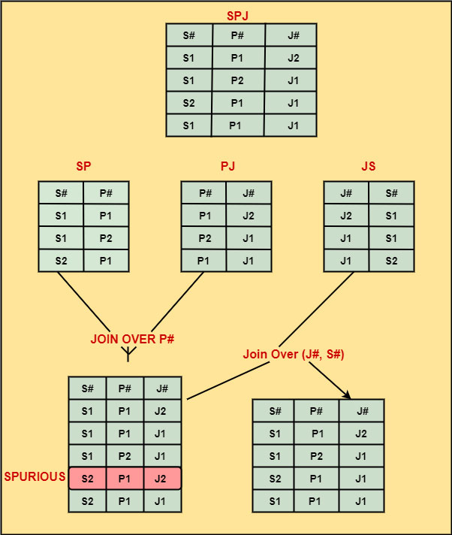

Slide 14
Thank you

